Slide 1
GE Girls Northeastern University 2018

Slide 2
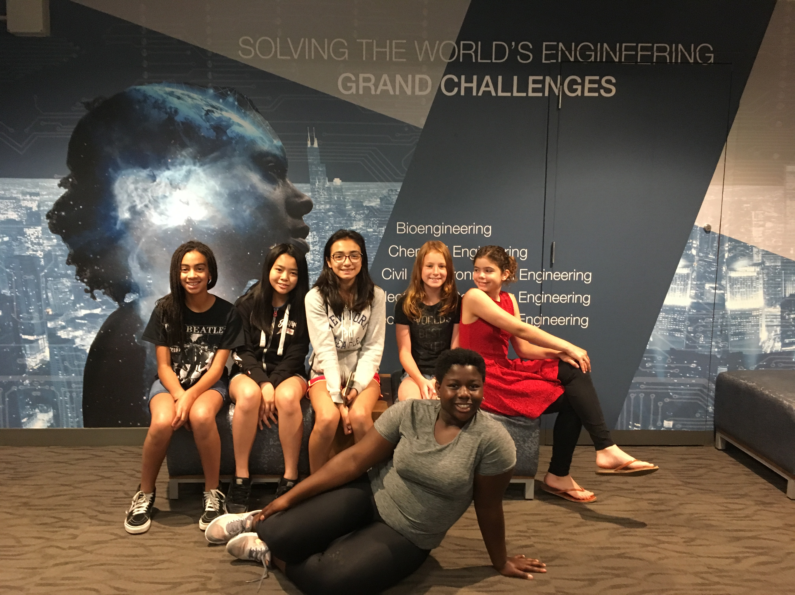
Team 3
Sofia
Yasmina
Calida
Nghi
Imani
Kendal

Slide 3
Key things we learned about Engineering, the Engineering Design Proces, and Engineering pathways
We learned that engineering solves problems in every day life
We learned that there are a large variety of different types of engineers to choose from, such as…
Industrial engineers
Chemical engineers
Mechanical engineers
Biochemical engineers
Civil engineers
The engineering design process: Ask → Imagine → Plan → Build/Create → Improve

Slide 4
Key things we learned about aviation and GE’s work in aviation33,
We learned that it takes drag, lift, thrust, and gravity for a plane to fly
They have more than 33,000 engines
GE works with other companies to get materials
GE is worldwide
Different types of engineers work together to build an engine

Slide 5
Key things we learned about Healthcare and GE’s work in healthcare
GE build advanced machines to help patients
V-scans
X-Rays
Ultrasounds
CT scans
MRI
Cell therapy provides an environment to modify cells
Makes materials that filters chemicals
Medicines in a form that suit the customers

Slide 6
Key things we learned about Power/Renewable Energy
Causes less pollution in the atmosphere
We learned different types of renewable energy:
Hydroelectric
Solar energy
Biomass
Geothermal
Wind
Not 100% efficient
Car batteries that are starting to be created by Tesla decrease the amount of pollution

Slide 7
As a team, what we want to learn more about..
As a team we want to learn more about the different types of engineers and career pathways in energy

