Slide 1
2018 GE Girls Northeastern University

Slide 2
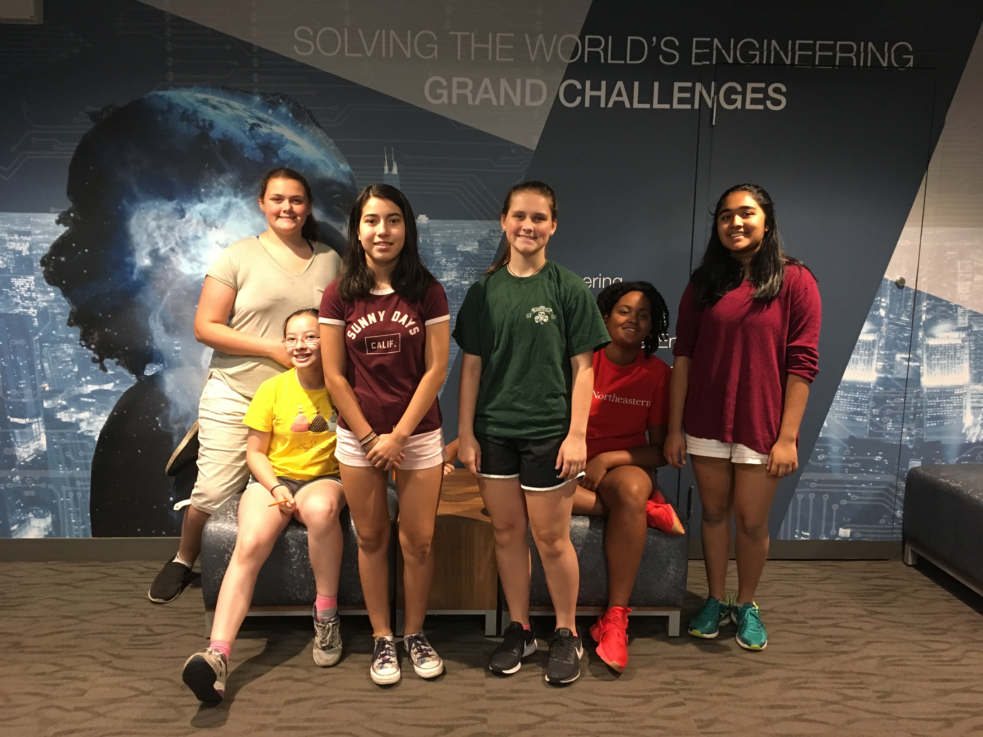
Team 2
Ayelen
Athena
Alexis
Saakshi
Emmanuelle
Colleen

Slide 3
Key things we learned about Engineering, the Engineering Design Process, and Engineering pathways
Engineering is innovation, fixing problems and creating solutions
Engineering design process helps improve designs
There are many different pathways in engineering
Engineering has changed many lives for the better
Engineering continues to create new opportunities

Slide 4
Key things we learned about aviation and GE’s work in aviation
GE has a large number of engines in flight
An aircraft powered by GE engine takes flight every two seconds
They make most of their own parts at GE
Many airlines depend on GE engines like Southwest

Slide 5
Key things we learned about Healthcare and GE’s work in healthcare
GE produces many x-rays, CT scans, MRIs, and ultrasounds
When we visited their office in Marlborough we saw their cell therapy machines at work
We also learned that GE trains their customers on how to use products
GE Healthcare is also working on an AI machine that could diagnose illnesses, broken bones, internal bleeding, etc.
We also learned about clinical trials and how important they are

Slide 6
Key things we learned about Power/Renewable Energy
Examples: Wind, Solar, Hydro
Renewable energy is: more efficient, easily accessible, and environmentally friendly
We use so much fossil fuels but we will soon run out (100 years) and we will lose power unless we change this
We can conserve energy and use much more renewable energy
Make more wind turbines, solar panels, and less coal, oil, and gas
Today about 20% of the world uses renewable energy and we are working to increase this percentage for the future

Slide 7
As a team, what we want to learn more about..
Ways to fuel planes with renewable energy
Surgery with AI
How things change to electricity and more ways we can make electricity

