Slide 1
2018 GE Girls Northeastern University

Slide 2
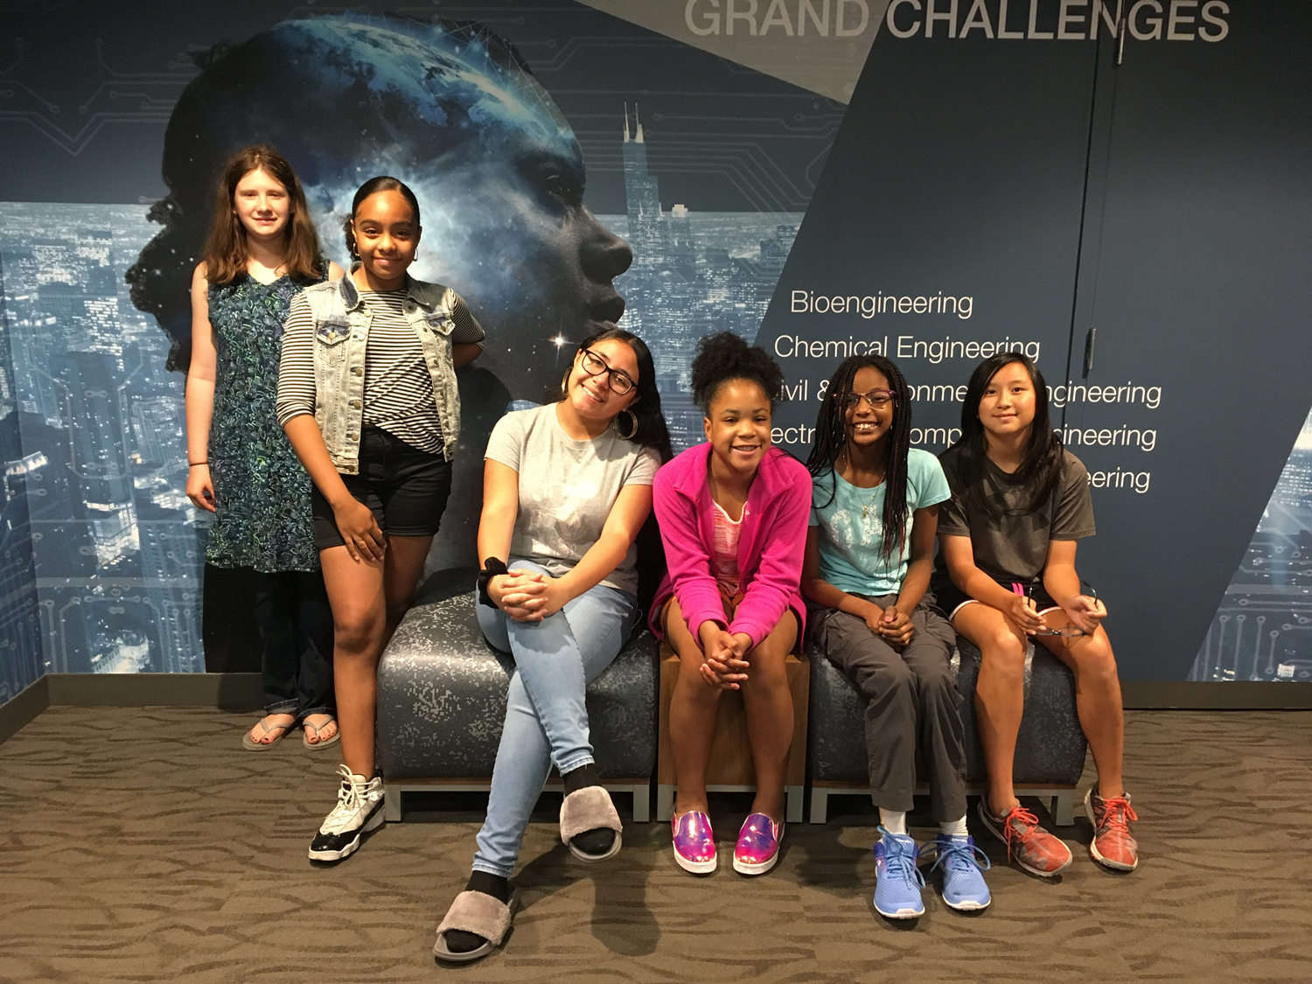
Team 1
Matilda
Rosanna
Amelia
Tatiana
Nagwa
Camille

Slide 3
Key things we learned about Engineering, the Engineering Design Process, and Engineering pathways
Building things to solve world problems. It is the art of innovation & creation towards making processes simpler & easier.
Ask, Imagine/Brainstorm, Design, Improve, Repeat
Getting internships, AP classes in math & science

Slide 4
Key things we learned about aviation and GE’s work in aviation
The lift, drag, gravity, thrust
The shape of the plane wing helps lift because it cuts through the air molecules, and using the jet engine lifts the plane
The way propellers are shaped helps fly the plane
When they test the planes, the pilot has to be skilled so that they do not crash the plane
They made the engines for military planes that were used in Afghanistan

Slide 5
Key things we learned about Healthcare and GE’s work in healthcare
They have cell therapy to cure blood cancer for small children
They clone the cells, and then alter the DNA to solve the problem. Then, they return the cells which cure cancer.
They make MRI, Ultrasound, CT, CAT, x-rays, which they collaborate with and make smaller
They genetically change cells to attack other cells
They are still working to cure cancer to help people

Slide 6
Key things we learned about Power/Renewable Energy
There are many big batteries all around the world; They cost about 55 billion dollars
There are lots of solar panels on houses and on solar farms
Different colors reflect light differently
The materials from the earth help power the wind turbine. The path is: transformer, plant, wires, houses
The smaller the fan, the faster it goes
The connection through circuits have different things happen

Slide 7
As a team, what we want to learn more about..
How cancer can be solved in more ways
How we can lighten plane engines
More about GE and how they make different products to help people
More about solar panels and the impact it has on our world
How there can be more cures to different diseases like lyme disease and different types of cancers
How they decide which machines to use (like the bioprocessor)
More on how they figured out what was the best idea on what kind of machines help the cells

